Slide 1
Lecture-1
Structured C
Md. Fazlul Karim Patwary
Professor
Institute of Information Technology Jahangirnagar University

Slide 2
History of Programming Language
In the 1940s the first recognizably modern, electrically powered computers were created. The limited speed and memory capacity forced programmers to write hand tuned assembly language programs. It was soon discovered that programming in assembly language required a great deal of intellectual effort and was error-prone.
Some important languages that were developed in this time period include:
1943 - Plankalkül (Konrad Zuse)
1943 - ENIAC coding system
1949 - C-10

Slide 3
History of Programming Language
In the 1950s the first three modern programming languages whose descendants are still in widespread use today were designed:
FORTRAN, the "FORmula TRANslator", invented by John W. Backus et al
LISP, the "LISt Processor", invented by John McCarthy et al.
COBOL, the COmmon Business Oriented Language, created by the Short Range Committee, heavily influenced by Grace Hopper.

Slide 4
History of Programming Language
The period from the late 1960s to the late 1970s brought a major flowering of programming languages. Most of the major language paradigms now in use were invented in this period:
Simula, invented in the late 1960s by Nygaard and Dahl as a superset of Algol 60, was the first language designed to support object-oriented programming. Smalltalk (mid 1970s) provided a complete ground-up design of an object-oriented language.
C, an early systems programming language, was developed by Dennis Ritchie and Ken Thompson at Bell Labs between 1969 and 1973.
Prolog, designed in 1972 by Colmerauer, Roussel, and Kowalski, was the first logic programming language.
ML built a polymorphic type system (invented by Robin Milner in 1978) on top of Lisp, pioneering statically typed functional programming languages.

Slide 5
History of Programming Language
The 1980s were years of relative consolidation. C++ combined object-oriented and systems programming. The United States government standardized Ada, a systems programming language intended for use by defense contractors. In Japan and elsewhere, vast sums were spent investigating so-called "fifth generation" languages that incorporated logic programming constructs.
Some important languages that were developed in this time period include:
1983 - Ada
1983 - C++
1985 - Eiffel
1987 - Perl
1989 - FL (Backus)

Slide 6
History of Programming Language
The rapid growth of the Internet in the mid-1990s was the next major historic event in programming languages. By opening up a radically new platform for computer systems, the Internet created an opportunity for new languages to be adopted.
Some important languages that were developed in this time period include:
1990 - Haskell
1990 - Python
1991 - Java
1993 - Ruby
1994 - PHP
2000 - C#

Slide 7
Programming Environment
Though Environment Setup is not an element of any Programming Language, it is the first step to be followed before setting on to write a program. When we say Environment Setup, it simply implies a base on top of which we can do our programming. Thus, we need to have the required software setup, i.e., installation on our PC which will be used to write computer programs, compile, and execute them.
We can write code in three ways:
A text editor to create computer programs.
A compiler to compile the programs into binary format.
An interpreter to execute the programs directly.

Slide 8
Text Editor
A text editor is a software that is used to write computer programs.
Some famous text editors are:
Notepad
Notepad++
Vim
Nano etc

Slide 9
Compiler
We can write our computer program using our favorite programming language and save it in a text file called the program file. But, the computer cannot understand the program directly given in the text format, so we need to convert this program in a binary format, which can be understood by the computer.
The conversion from text program to binary file is done by another software called Compiler and this process of conversion from text formatted program to binary format file is called program compilation. Finally, we can execute binary file to perform the programmed task.

Slide 10
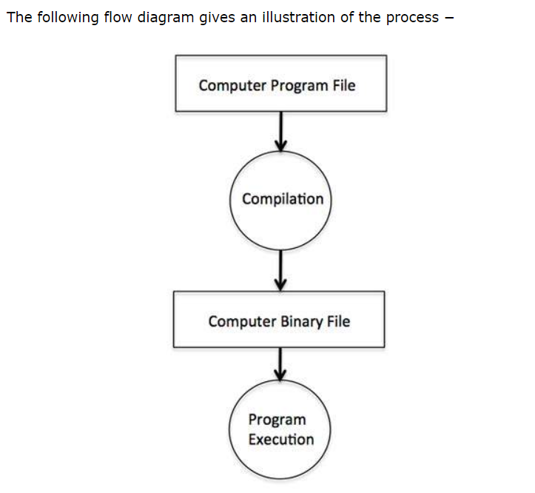
Compiler

Slide 11
Interpreter
We just discussed about compilers and the compilation process. Compilers are required in case you are going to write your program in a programming language that needs to be compiled into binary format before its execution.
There are other programming languages such as Python, PHP, and Perl, which do not need any compilation into binary format, rather an interpreter can be used to read such programs line by line and execute them directly without any further conversion.

Slide 12
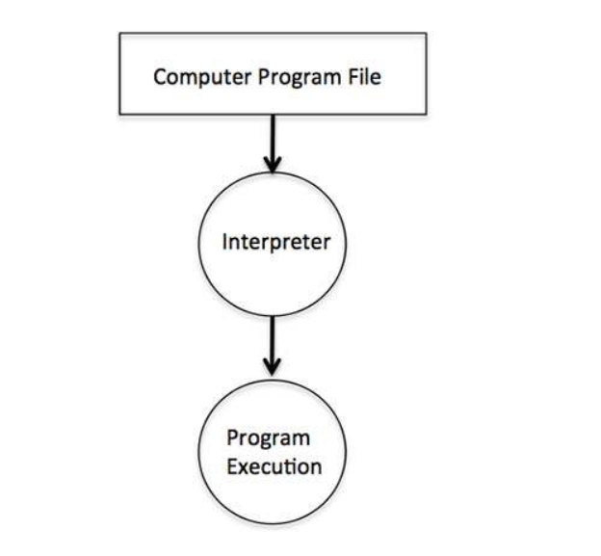
Interpreter

Slide 13
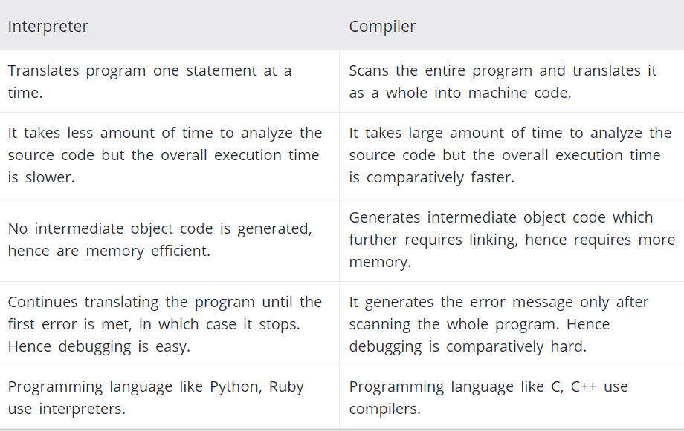
Difference Between Compiler and Interpreter

Slide 14
Structural Programming
Structural Programming is a technique for organizing and coding computer programs in which a hierarchy of modules is used, each having a single entry and a single exit point, and in which control is passed downward through the structure without unconditional branches to higher levels of the structure.
In structural Programming a program is broken into different sub-programs which is also called functions, subroutines, modules or procedures.
Structured programming minimized the chances of the function affecting another. It supported to write clearer programs.

Slide 15
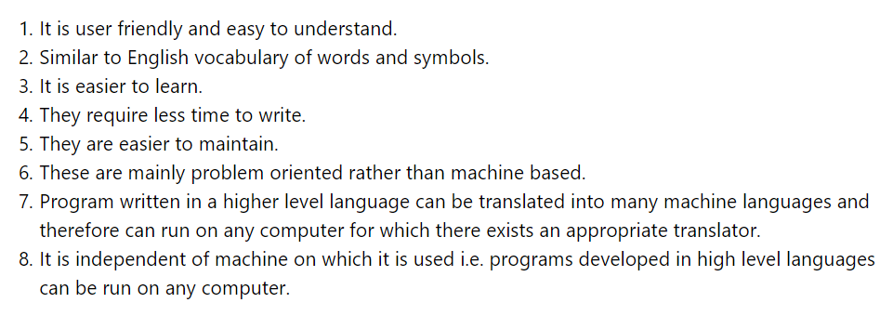
Advantage of Structural Programming

Slide 16
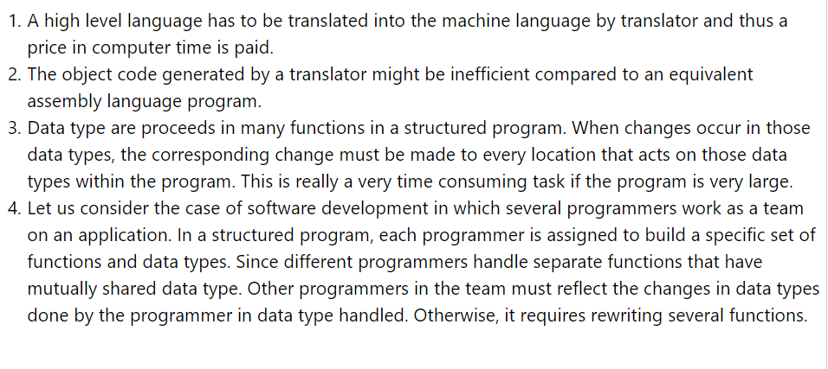
Disadvantage of Structural Programming

Slide 17
C programming Fundamentals
C programming language is a Structural Programming Language. We will use C programming language to see how Structural Programming language works.
A C program basically consists of the following parts −
Preprocessor Commands
Functions
Variables
Statements & Expressions
Comments

Slide 18
Tokens
A C program consists of various tokens and a token is either a keyword, an identifier, a constant, a string literal, or a symbol.
Example:
printf(“Hello world\n”);
Here tokens are: printf , ( , “Hello world\n” , ) and ;

Slide 19
Semiclone
In a C program, the semicolon is a statement terminator. That is, each individual statement must be ended with a semicolon. It indicates the end of one logical entity.
Example:
printf(“Welcome to IIT”);

Slide 20
Comments
Comments are like helping text in your C program and they are ignored by the compiler. They start with /* and terminate with the characters */ as shown below −
*/ This is my first comment.
This is a multi line comment*/
We can also write one line comment as shown below:
// This is a single line comment

Slide 21
Identifiers
A C identifier is a name used to identify a variable, function, or any other user-defined item. An identifier starts with a letter A to Z, a to z, or an underscore '_' followed by zero or more letters, underscores, and digits (0 to 9).
C does not allow punctuation characters such as @, $, and % within identifiers. C is a case-sensitive programming language. Thus, MyIdentifier and myidentifier are two different identifiers in C.

Slide 22
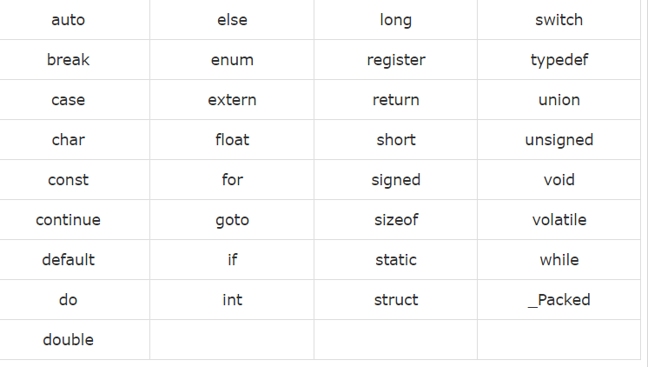
Keywords
The following list shows the reserved words in C. These reserved words may not be used as constants or variables or any other identifier names.

Slide 23
C program structure
uses standard library
input and output functions
(printf)
#include <stdio.h>
int main (void)
{
printf ("Programming in C.\n");
return 0;
}
begin of program
statements
end of program
main: a special name that indicates where the program must begin execution. It is a special function.
first statement: calls a routine named printf, with argument the string of characters “Programming is fun \n”
last statement: finishes execution of main and returns to the system a status value of 0

Slide 24
Compiling and running C programs
Editor
Source code
file.c
Compiler
Object code
file.obj
Libraries
Linker
Executable code
file.exe
IDE (Integrated Development Environment)

Slide 25
Debugging program errors
Editor
Syntactic
Errors
Source code
file.c
Compiler
Object code
file.obj
Libraries
Linker
Executable code
file.exe
Semantic
Errors

Slide 26
Syntax and Semantics error
Syntax errors: violation of programming language rules (grammar)
"Me speak English good."
Use valid C symbols in wrong places
Detected by the compiler
Semantics errors: errors in meaning:
"This sentence is excellent Italian."
Programs are syntactically correct but don’t produce the expected output
User observes output of running program

Slide 27
Variables
Programs can use symbolic names for storing computation data and results
Variable: a symbolic name for a memory location
programmer doesn’t has to worry about specifying (or even knowing) the value of the location’s address
In C, variables have to be declared before they are used

Slide 28
Variables - Examples
int a; // declaring a variable of type int
int sum, a1,a2; // declaring 3 variables
int x=7; // declaring and initializing a variable
a=5; // assigning to variable a the value 5
a1=a; // assigning to variable a1 the value of a
L-value
R-value
a1=a1+1; // assigning to variable a1 the value of a1+1
// (increasing value of a1 with 1)

Slide 29
Variable names: rules
Rules for valid variable names (identifiers) in C :
Name must begin with a letter or underscore ( _ ) and can be followed by any combination of letters, underscores, or digits.
Any name that has special significance to the C compiler (reserved words) cannot be used as a variable name.
Examples of valid variable names: Sum, pieceFlag, I, J5x7, Number_of_moves, _sysflag
Examples of invalid variable names: sum$value, 3Spencer, int.
C is case-sensitive: sum, Sum, and SUM each refer to a different variable !
Variable names can be as long as you want, although only the first 63 characters might be significant. But it’s not practical to use variable names that are too long.
Choice of meaningful variable names can increase the readability of a program

Slide 30
Using and Displaying Variables
#include <stdio.h>
int main (void)
{
int sum;
sum = 50 + 25;
printf ("The sum of 50 and 25 is %i\n", sum);
return 0;
}
Variable sum assigned expression 50+25
Value of variable sum is printed in place of %i

Slide 31
Displaying multiple values
#include <stdio.h>
int main (void)
{
int value1, value2, sum;
value1 = 50;
value2 = 25;
sum = value1 + value2;
printf ("The sum of %i and %i is %i\n",value1, value2, sum);
return 0;
}
The format string must contain as many placeholders as expressions to be printed

Slide 32
Use of comments in a program
Comment statements are used in a program to document it and to enhance its readability.
Useful for human readers of the program – compiler ignores comments
Ways to insert comments in C:
When comments span several lines: start marked with /*, end marked with */
Comments at the end of a line: start marked with //

Slide 33
Use of comments in a program
/* This program adds two integer values
and displays the results */
#include <stdio.h>
int main (void)
{
// Declare variables
int x1, x2, sum;
// Assign values and calculate their sum
x1= 50;
x2= 25;
sum = x1+ x2// Display the result
printf ("The sum of %i and %i is %i\n",x1, x2, sum);
return 0;
}

